Slide 1
Hardware Software Platforms Project Presentation
DE1-Temperature sensor
Luypaert Charlotte
Vanvilthoven Julien
Charlotte.LUYPAERT@student.umons.ac.be
Julien.VANVILTHOVEN@student.umons.ac.be

Slide 2
Plan
Project description
I2C explanations
Driver state machine and simulation
Application simulation
Driver and application simulation
Simulation on the oscilloscope
Video
Demonstration
Sources

Slide 3
Project description
Goal: Learn how to manage a temperature sensor on an FPGA (Field-Programmable Gate Array)
Use of the Quartus software to implement our project
Make simulations to be sure everything works properly before sending the code on a chip
Implement our code on the Altera Cyclone V SoC.

Slide 4
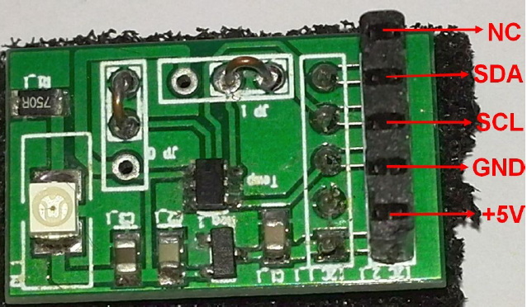
I2C (inter integrated circuit)
Goal: Making communication between electronic components with three wires:
Data signal: SDA
Clock signal: SCL
Electric reference signal:Ground

Slide 5
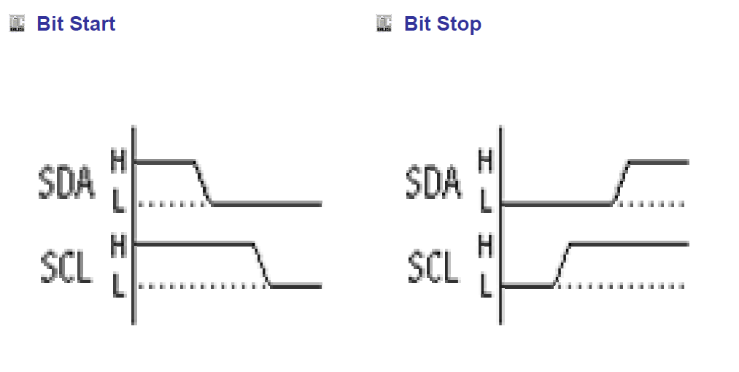
i2C
Takeover of the bus :
Before data transmission : SCL and SDA at 1
Start condition : SCL at 1 and SDA at 0
Stop condition : SCL at 1 and SDA at 1
Bus free→taking control→circuit becomes Master and generates clock signal.

Slide 6
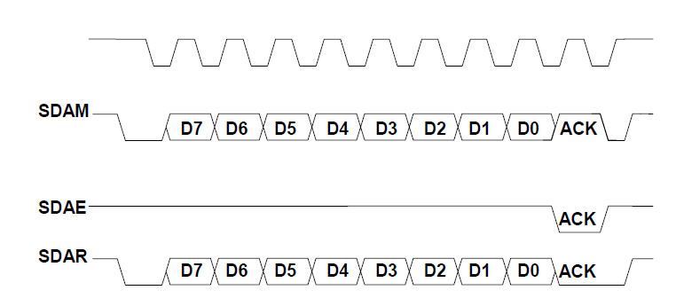
i2C
Byte transmission
SCL
Master
Slave
SDA

Slide 7
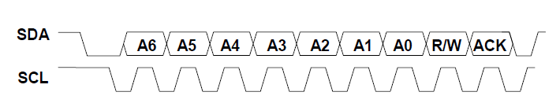
i2C
Adresses transmission
Register address
Device address
Data
The address is defined on seven bits. The eighth bit is the R/W wich determines if the master wants to read or write.

Slide 8
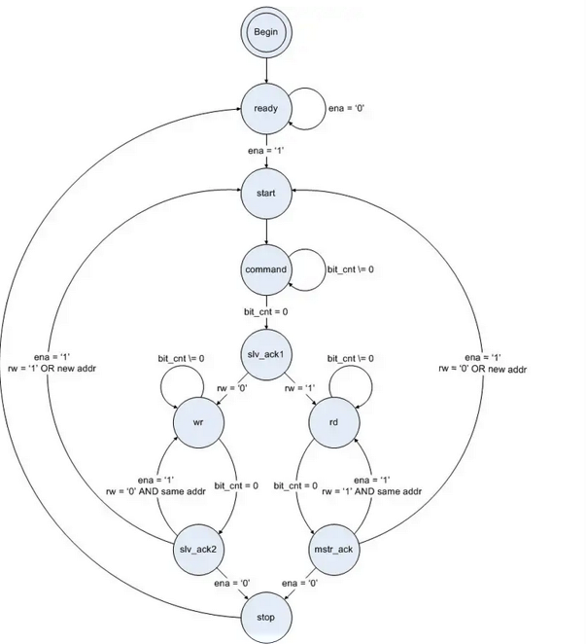
State-machine of the driver
Found on: https://www.digikey.com/eewiki/pages/viewpage.action?pageId=10125324

Slide 9
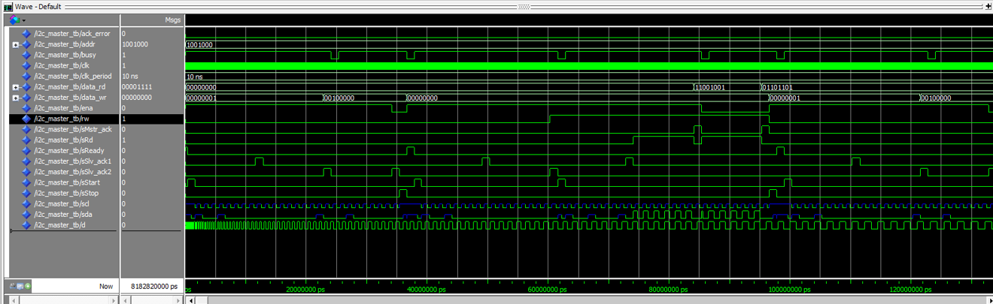
Driver simulation
To see if our code works well, we put a fake data (d). Otherwise we can’t see if the data is read or not.
The simulations have been done on ModelSim

Slide 10
Application
Temperature sensor
VHDL Code based on PIC Code
Read of temperature on the leds (the eight most significant bits are read)

Slide 11
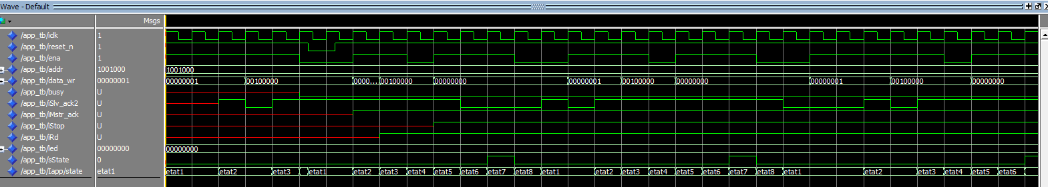
Application simulation
The simulations have been done on ModelSim

Slide 12
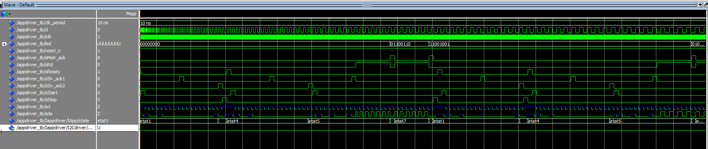
Driver and application Simulation
Assembly of the two codes: the driver and the application

Slide 13
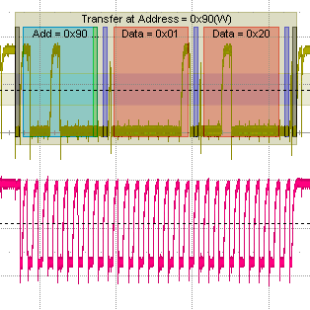
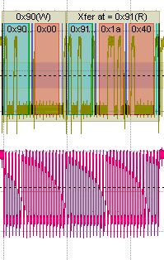
Simulation on the oscilloscope
To check the I2C data frame, we connected the SDA and the SCL on the oscilloscope
Setting the resolution
Reading the temperature
Device address
Registers address
Writing the 0x00
Reading the 2 bytes

Slide 14
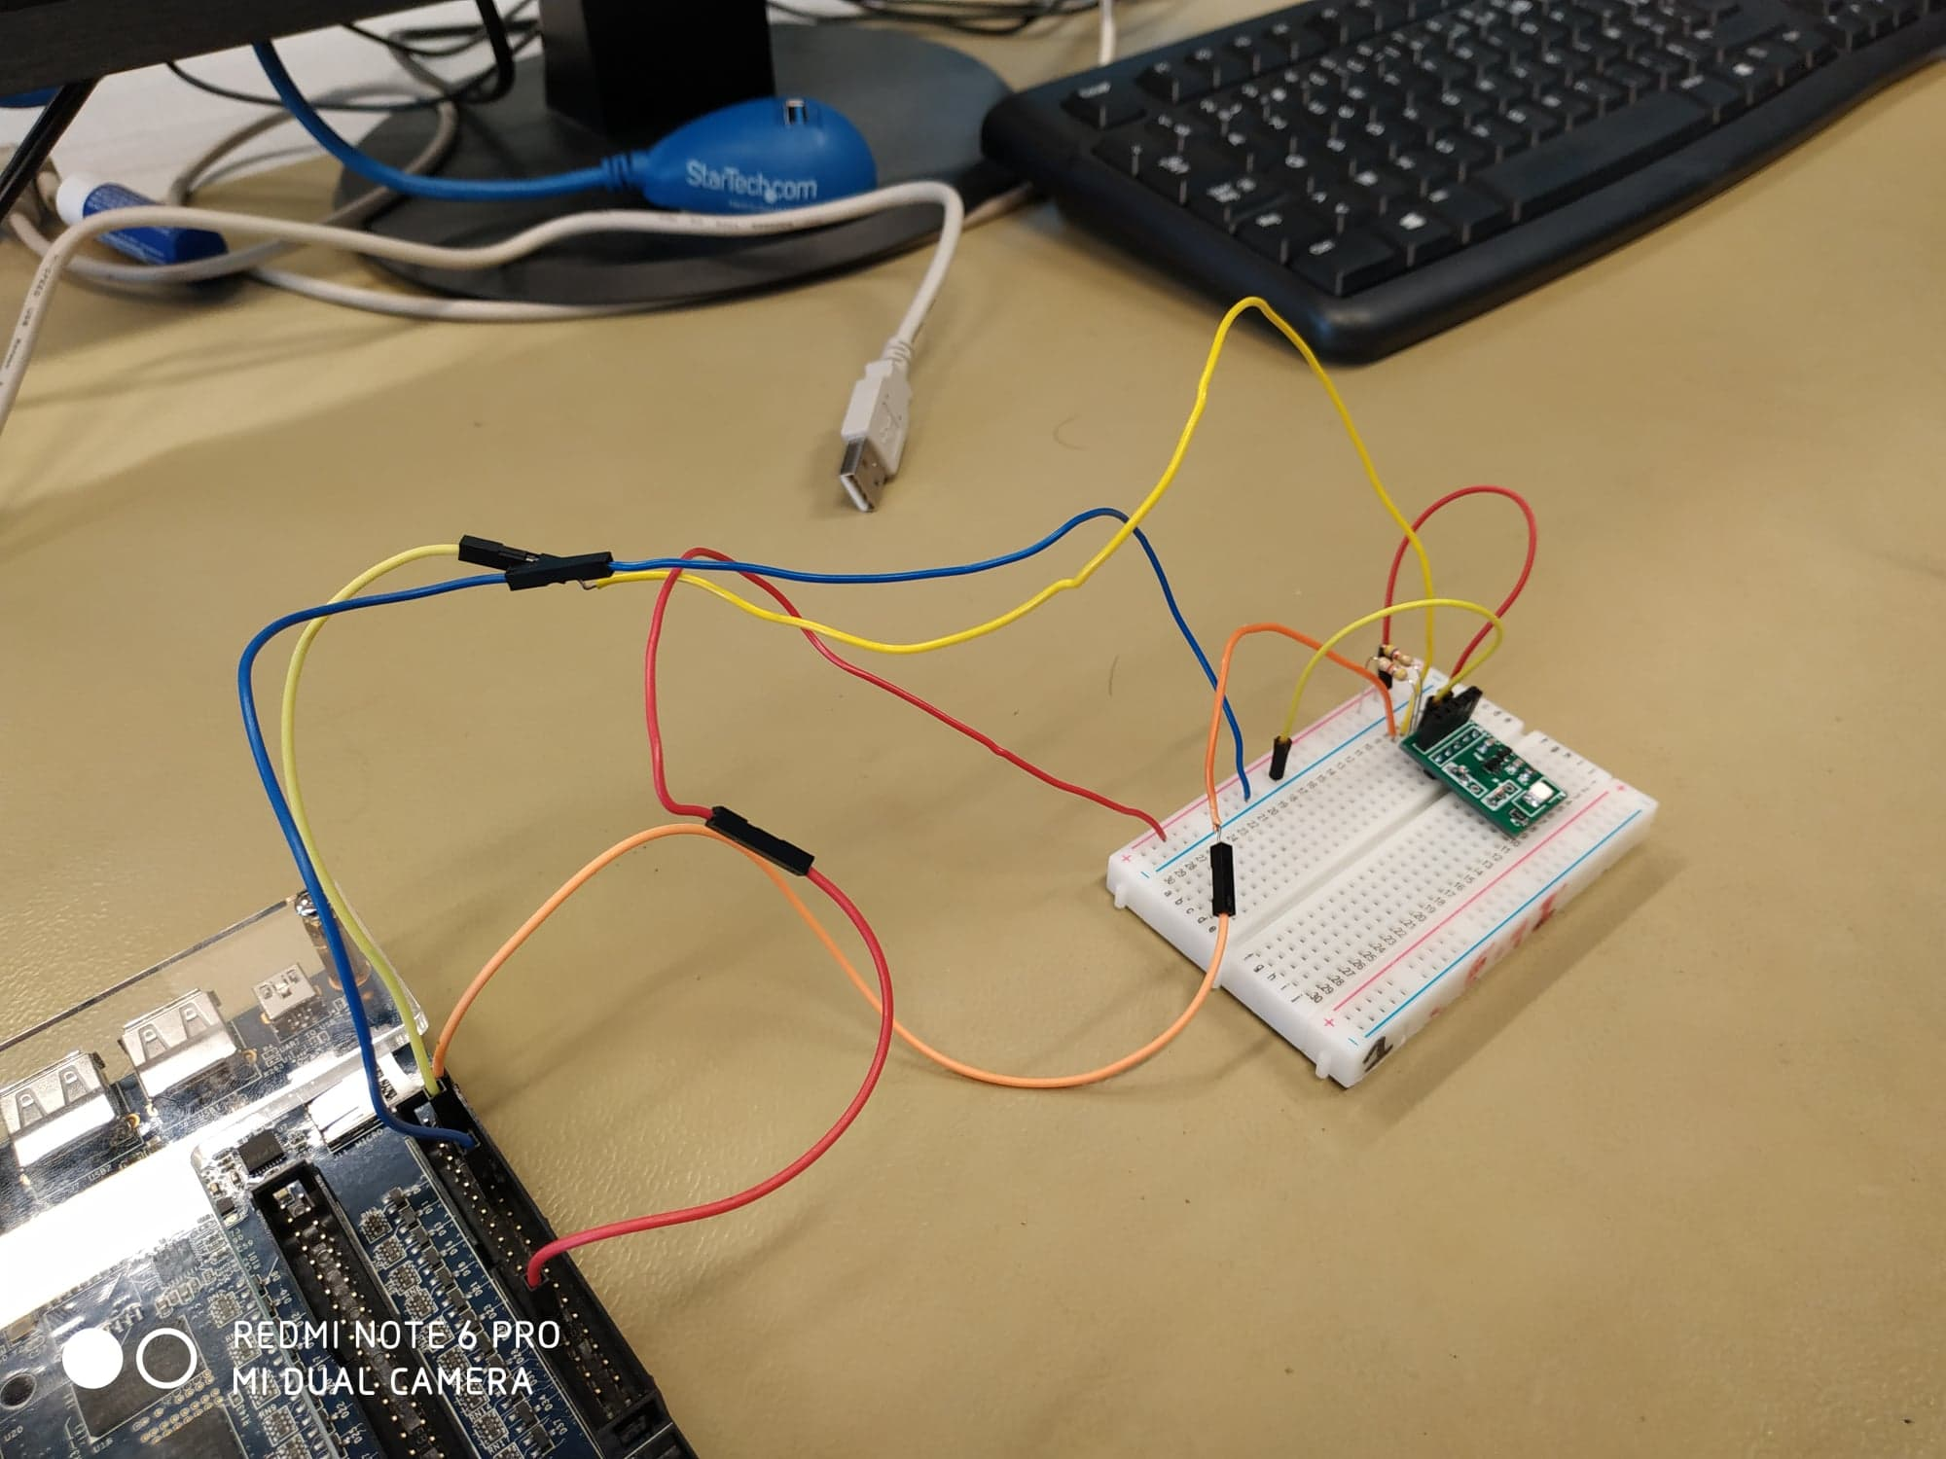
Assembly on breadboard
The two pins, SCL and SDA are common collector. To polarize them, we have to add two resistors:
One between VDD and SCL
One between VDD and SDA

Slide 15


Slide 16
A short demonstration

Slide 17
Conclusion

Slide 18
Sources
https://www.les-electroniciens.com/sites/default/files/cours/cours_i2c.pdf
I2C Introduction au bus I2C, Camille Diou
url:https://www.les-electroniciens.com/sites/default/files/cours/cours_i2c.pdf

